Slide 1
Determining Treatment Cost of Pallets Under Dielectric Heating Criteria
C.D. Ray, M.K. Dubey, S. Shahidi, J.J. Janowiak, and K. Hoover
The Pennsylvania State University
September, 2014

Slide 2
Dielectric Properties of White Oak RH: 90% Temp(C): 25 Source: James 1975
 |  | Dielectric constant | Dielectric loss tangent | Dielectric loss factor | Permittivity
 |  | ε' | tanδ | ε" | ε*
10 MHz | Radial | 8.3 | 0.35 | 2.91 | 5.40
 | Tang | 7.3 | 0.21 | 1.53 | 5.77
 | Long | 14 | 0.33 | 4.62 | 9.38
50 MHz | Radial | 6.6 | 0.24 | 1.58 | 5.02
 | Tang | 6.6 | 0.16 | 1.06 | 5.54
 | Long | 12 | 0.20 | 2.40 | 9.60
Notes:
John, Manoj to comment

Slide 3
Transforming Power Consumption to Cost
Power Consumption | Treatment Time | Load+Unload Time | Production Hrs/Day | Loads/Day | Total Treatment Time under Power | Pallets Eq. Treated per day | Energy consumed per day | 1 kilowatt-hour (kWh) cost | Energy cost per day | Energy cost per month | Energy cost per year | Energy cost per pallet
kWh | min | min |  |  | hrs |  | kWh | Cents | US$ | US$ | US$ | US$
675 | 30 | 15 | 8 | 11 | 5.33 | 964 | 3600 | 6.81 | $245 | $7,355 | $88,258 | $0.25
150 | 135 | 15 | 8 | 3 | 7.20 | 289 | 1080 | 6.81 | $74 | $2,206 | $26,477 | $0.25
Notes:
By conversion of the power requirements to heat specific species under ISPM-15 defined protocol, it is possible to determine the approximate variable cost of such treatment on a per-pallet or per-time period basis, as is done here. In this example, two different size RF ovens are examined; one, a 675 kWh oven that would be required to heat white oak to 60C within 30 minutes, and a similar oven but with a smaller 150 kWh generator which would bring the load to 60C over 135 minutes. As can be seen in the results here, the energy cost per pallet (last column) is exactly the same, since the amount of energy to heat identical samples of wood to a given temperature is the same, regardless of how long a time period that amount of energy is applied. The energy cost per time period calculations result in varying costs, but these costs reflect different production levels...the more powerful the oven, the more wood can be treated in a given period of time. This results in a higher use of, and therefore cost of, energy, but since more pallets are being treated, the cost per pallet treated stays the same.
This relationship carries at least two significant implications.
If ISPM-15 protocol for dielectric treatment remains for a 30-min requirement, then the more powerful dielectric chambers will be required. While this means more production will be possible, it also means the capital cost of the chambers will be prohibitive to all but the largest heat treaters.
However, if the protocol is changed to allow treaters to achieve the 60C requirement over a longer period of time, smaller generators will be possible and the capital cost to potential treaters will be reduced. The importance of this fact is that such a condition will allow smaller treaters to attain the same power cost (or fuel cost) per unit as the larger treaters, thereby increasing the likelihood that the technology will be adopted on a wider basis.

Slide 4
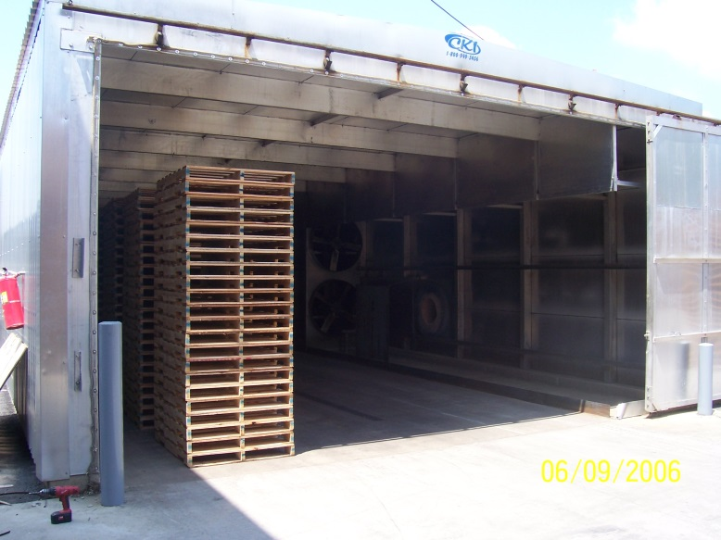
In the previous example, we demonstrated how the energy cost, which is by far the largest component of treatment variable cost, can be calculated for dielectric treatment chambers. How then, do these projected costs compare to traditional heat treatment as currently practiced?

Slide 5
Current HT Costs in US
Data collected in 2013-14 from US pallet treaters via email survey and direct survey at major pallet industry conference. Generally a tepid response to survey…many responses incomplete or questionable. Somewhat surprisingly, many companies do not seem to know their actual cost of pallet treatment, since the treatment costs are not typically broken out from general operations in company accounting records. Hearsay and off-the-cuff cost estimates were found unreliable when compared to actual cost data.
Companies were surveyed on HT chamber costs, age of chamber, capacity, annual production, fuel type and consumption, fuel price, maintenance costs, and hours in operation in past year.
Survey data from eight operational treatment chambers were deemed appropriate, reliable and accurate. The cost numbers of these surveys generally reflected findings of a major pallet industry cost study performed in 2006-07 performed with proprietary data.
Cost component distributions were generated through Monte Carlo simulation that conformed to the cost data approximations gleaned from both studies.
As future work generates more interest in the technology, future data points will be collected to validate the cost curves generated for and assumed in the study. Industry sensitivity towards cost data sharing, unfortunately, ensures that validation data will be minimal.

Slide 6
Statistical Assumptions Made to Generate Cost Curves
Maintenance Cost = Exponential(.1)
Fuel Cost = Inverse Gamma(2,10)
Electricity Cost = Gamma(2,1)
Total Variable Cost = (M + F + E)
Total Power Cost = (F + E)
Notes:
In this step, various distributions were examined to determine which might come closest to fitting actual operational cost data as observed from researcher’s experience in this and previous study. These distributions were found to come closest to representing actual results. Future studies will expand on these assumptions according to the amount of data that becomes available during the technology-transfer phase of implementation.

Slide 7
Variable Cost of Pallet Heat Treatment
Notes:
Our team has been working to collect data on costs of current pallet treating operations in the United States. These curves represent the variable cost components as simulated across the industry in the United States, based on the data collected.
The red curve represents the cost of fuel used for heating the conventional treatment chambers. It demonstrates a range of from about 2 cents per pallet to over 60 cents per pallet, which represents the range of highest volume producers with low variable cost to low volume treaters with their necessarily higher cost per pallet, due to less efficient operation and higher cost of fuel used. Average fuel cost per pallet would be expected to be about 12 to 15 cents per pallet.
The purple curve represents the cost of electricity used in running the fans and controllers of the kilns. It demonstrates a range of from about 5 to 10 cents per pallet. Ignore the wiggly tail of this curve; it is simply the extension of the polynomial curve fitted to the data and does not represent any true operational costs.
The green curve represents the cost of maintenance used in keeping the kilns operating over the course of the year. It demonstrates a range of from about 3 to 20 cents per pallet.
The blue curve is the summation of these three cost curves; we will call it total variable cost. It demonstrates a range of from about 10 to 70 cents per pallet, with an average total variable cost of around 32 cents per pallet.

Slide 8
Power Cost of Conventional Heat Treatment
Notes:
Since we demonstrated earlier a means of calculating the “power cost” of dielectric heat treatment, we naturally would like to make an apples-to-apples comparison of power cost in conventional heat treatment. The first step in this process would be to generate a curve that combines the fuel cost and electricity cost into one “power cost curve” for conventional treating facilities currently in operation. The blue curve shown here is the representation of that combined “power cost”; it ranges from about 3 to 60 cents per pallet, with a mean of about 15 cents. We can then compare this cost curve to our calculation of power cost in the dielectric chamber, which in the example given earlier was about 25 cents per pallet.
However, the difference is that we have a cost curve for the conventional heat treatment facilities, based on simulation of actual cost variances collected in our study, versus a single point estimate of 25 cents for dielectric treatment, based on an electricity cost per kilowatt-hour of 6.81 cents, which it was locally at the time of our power calculations. What is needed is a way to vary the power cost of dielectric heating over a range of electricity cost per kilowatt-hour.

Slide 9
When Does Dielectric Work?
Notes:
To answer this question, we can simply overlay an extrapolation of the calculated dielectric power cost on the simulated conventional power cost, and analyze what the data are telling us.
First, let’s look at the red line in the graph. This line is an extrapolation of our dielectric power cost for treatment of white oak based on a range of electricity cost from 5 to 19 cents per kilowatt-hour (secondary y-axis). Recall that in our preliminary example we used an electricity cost of 6.81 cents per kilowatt-hour. If we follow the second horizontal dotted line from the secondary y-axis to its intersection with the red line, we see that our power cost at that cost of electricity, for white oak, would be about 25 cents (x-axis), which is what we estimated earlier. We see from the simulated blue power curve, roughly 25% of the conventional operations have power costs greater than 25 cents. Therefore, these 25% of the operations could reduce their variable power cost by switching from conventional to dielectric treatment. Of course, this decrease in power cost would have to be great enough to justify the capital investment in the dielectric chamber, as calculated in an ROI analysis. Depending on the specific circumstances of each case, some of these 25% will find it beneficial to make the investment; others will not.
Another way to use the red line is to read the graph in the other direction. For instance, if you were a treating operation with a 40 cents per pallet power cost, you could follow the dashed line from 0.4 on the x-axis up until you intersect the red line, and then by going over to the secondary y-axis, you find 10 cents per kilowatt-hour. That is, you have discovered that as long as your electricity cost is below 10 cents per kilowatt hour, dielectric heat treatment would lower your treatment power cost.
Let’s now consider what happens when the power consumption of the wood species treated is less than white oak. The green line represents a species that requires only 75% of the power to treat than white oak, and the purple line represents a species that requires only half the power of white oak. The same operator that has a 40 cents per pallet power cost in his conventional treatment operation, would find that dielectric treatment would lower his power cost at any electricity cost of less that 14 cents per kilowatt-hour if the typical species he treats requires only 75% the power of white oak. Our further investigations will determine what these power requirements will be for other species that are typically used in pallet and packaging operations.
The other side of this graphic is that roughly one-half of the current conventional treatment operations (the operations represented by the left-hand side of the blue curve) will not see a cost advantage in dielectric treatment, based on their current cost advantages. These are the operations that currently have a power cost at roughly 15 cents per pallet and below.
However, that conclusion rests on the assumption that cost differentials between current fuels and electricity remain the same. Many of the lowest cost conventional treatment operations use by-product wood as their primary fuel source, and that fuel source may not exist in many places at the cheap prices enjoyed by North American operations.
A large percentage of conventional treaters in the mid-level cost ranges use natural or propane gas for fuel. If the cost of these fuels increase faster that the cost of electricity in a region, then the effect would be to move the blue cost curve to the right relative to the dielectric power cost lines, thereby making dielectric treatment justifiable to a larger percentage of operations.

Slide 10
In Conclusion,
Dielectric treatment costs vary with wood species, moisture content, dielectric heating frequency, and technology efficiency.
Capital investment cost in dielectric treatment is determined by heating rate requirements.
Dielectric treatment shows more promise for higher-cost, lower-volume treaters, if heating rate requirements are loosened.
The results presented here are focused on variable costs that are based on fundamental energy engineering relationships. As such, they will be relative to all heat treatment scenarios. Capital costs and other fixed costs are case-specific and cannot be accurately generalized.

