Slide 1

Comparison of potential environmental impacts of microwave and RF phytosanitary treatment of wooden pallets to conventional heat treatment and methyl bromide treatments
Charles Ray, Sebastian Anil , Li Ma, Shirin Shahidi, Kelli Hoover, and John Janowiak
School of Forest Resources, Department of Industrial Engineering, Department of Entomology
The Pennsylvania State University
September, 2011
Notes:
Introductory comments

Slide 2

Problem Description and Motivation
Phase out of Methyl Bromide due to high ozone depletion potential
Conventional heat treatment methods generate high life-cycle environmental impacts and costs
High capital costs, operating costs during heat treatment of pallets
Absence of LCA studies that compare ISPM treatment methods
Life Cycle Analysis of pallet types and treatment methods

Slide 3
Research Objectives
Determine the environmental impacts of all pallet life cycle stages
Compare Heat treatment, Fumigation, microwave, and RF heating using life-cycle analysis methodology
Compare current Heat Treating schedule vs. proposed schedules
Support the development of ISPM guidelines to include microwave and RF heating as an alternative and environmentally viable treatment option
Life Cycle Analysis of pallet types and treatment methods

Slide 4
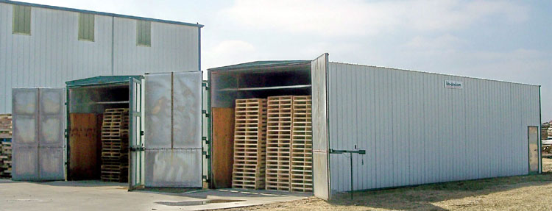
Conventional Heat Treatment

Slide 5
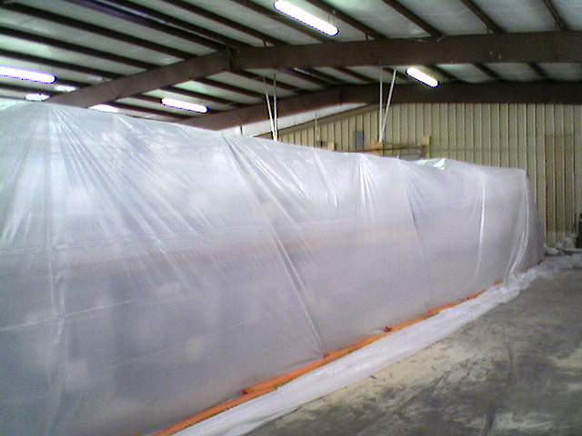
Methyl bromide treatment

Slide 6
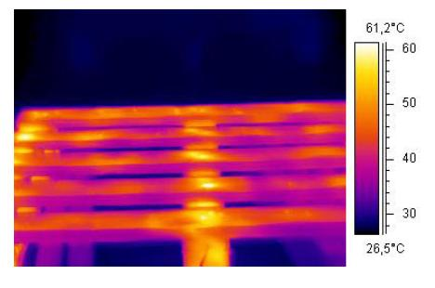
Microwave treatment
Infrared Temperature Pattern of a Pallet after Two Minutes of Exposure to MW Irradiation at 2kW Power (De Leo et al. , 2006)

Slide 7
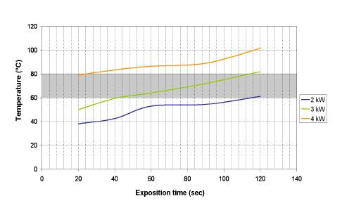
Optimizing the MW system

Slide 8
Life Cycle Analysis
Goals
  Compare environmental impacts of:
    Conventional Heat Treatment
    Methyl Bromide Fumigation
    Microwave Heating
    Radio Frequency Heating
  Compare environmental impacts of:
    56C/30M
    60C/60M
    71C/75M

Slide 9
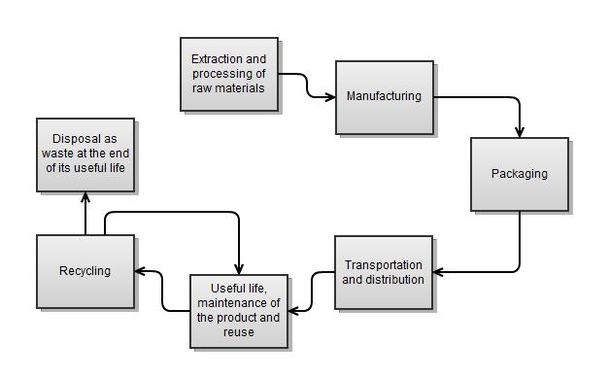
Life Cycle of a Product

Slide 10
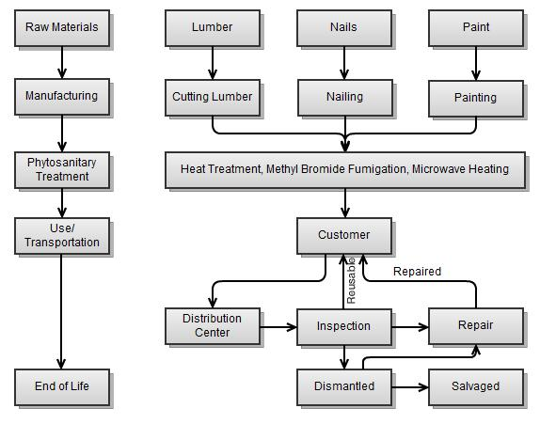
Process Map for Wooden Pallet LCA

Slide 11
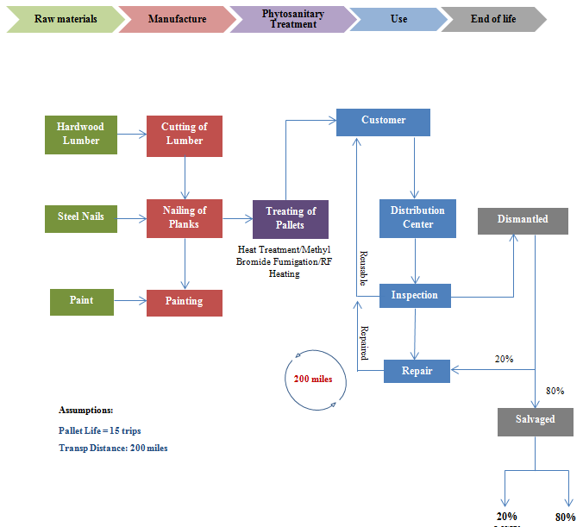
Life Cycle Analysis – System boundaries
Notes:
This graph illustrates that the “system boundaries” as defined for our work include the complete life cycle from the harvesting and production of raw materials to the disposal or recycling of the pallets at the end of their useful life. As subsequent slides will illustrate, the phytosanitary treatment of the pallets comprises a fairly small portion of the life-cycle impact of the pallet product overall.

Slide 12
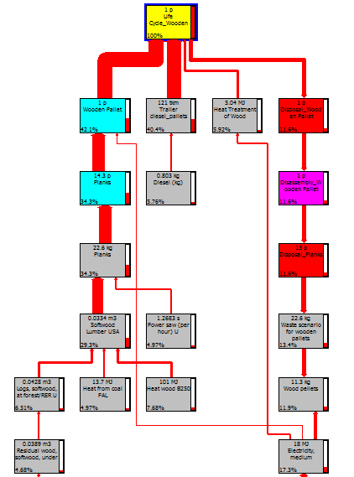
Life Cycle Analysis – Wooden Pallets
Global Warming Impacts
Life Cycle Stage | Carbon Footprint (Kg CO2 eq.)
Manufacture | 7.86
Heat Treatment (current ISPM 15) | 2.20
Transportation | 8.58
End of Life | 2.03
Total | 20.67
Notes:
This graph gives the viewers a visual of the last statement…the narrow band of the third column illustrates the relatively small flow of environmental impact contributed by pallet treatment compared to pallet manufacture (1st band), transport (2nd band), and end-of-life disposition (4th band). The table quantifies the carbon footprint portion of the environmental impacts, and shows that heat treatment contributes about 10% of the total pallet use carbon footprint.

Slide 13
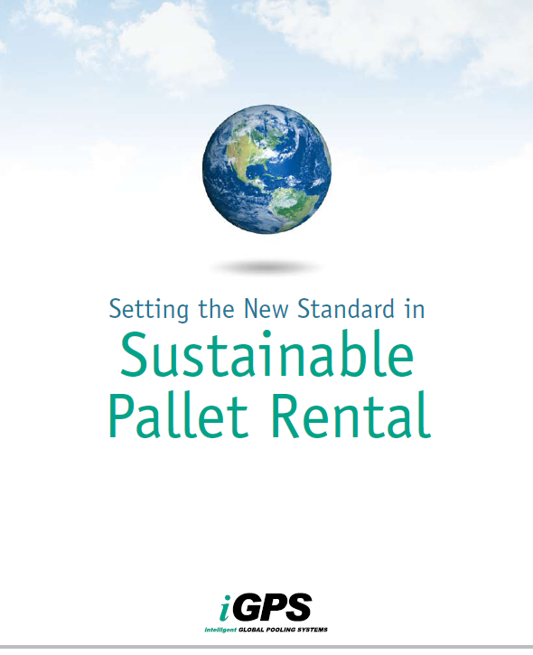
From 2008 ERM-iGPS report
“For the baseline scenarios, the results of this study showed that the iGPS plastic pallet had lower environmental impacts in all impact categories compared to the typical pooled wooden pallet…”

Slide 14
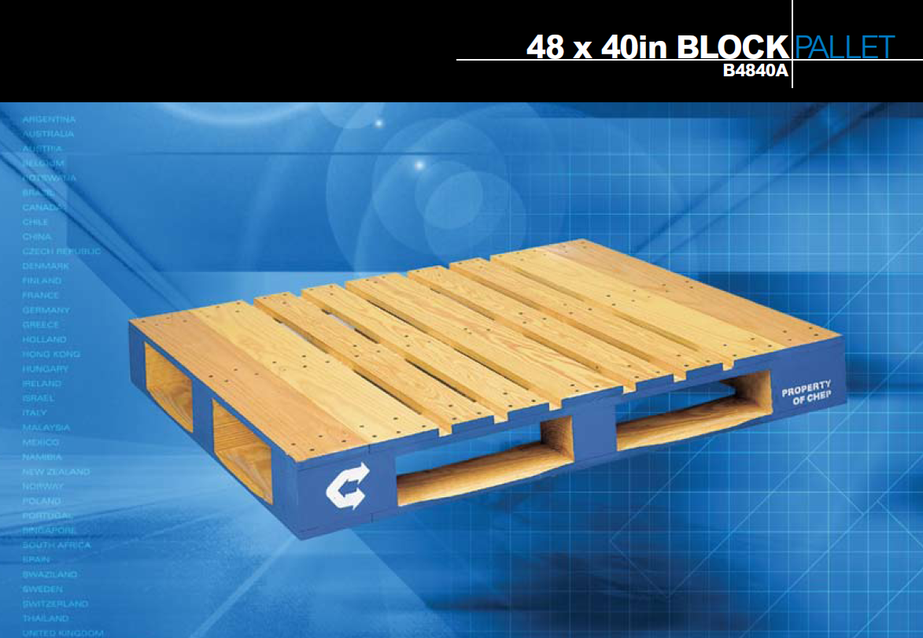
From 2009 Franklin Associates - CHEP Study
“According to the study, the CHEP system generates 48% less solid waste, consumes 23% less total energy and generates 14% less greenhouse gas than pooled plastic pallets.”
Who’s right?

Slide 15
Pallet LCA Assumptions
Variable |  | CHEP Study |  | iGPS Study |  | PSU Study
 |  | Wooden | Plastic | Wooden | Plastic | Wooden | Plastic
Functional Unit |  | 100,000 pallet loads of delivered product
Pallet Life |  | 30 trips | 60 trips | 15 trips | 100 trips | 15 trips | 100 trips
Loss Rate |  | n/d | n/d | 4% | 1% | 0% | 0%
Miles Traveled per trip | New delivery | n/d | n/d | 500 | 500 | 75 | 175
 | Recurring use | 250* | n/d | 1190 | 40 | 125 | 250
Decabromine for plastic? |  |  | n/d |  | no |  | with and without
Pallet weight |  | 65 lbs | n/d | 70 lbs | 47.5 lbs | 45 lbs | 50 lbs
Life Cycle Analysis of pallet types and treatment methods

Slide 16
LCA Comparison of Wood and Plastic Pallets
Global Warming Impacts (Kg CO₂ eq.)
 | Wood Pallets |  |  | Plastic Pallets
 | Heat Treatment | Me-Br Fumigation | RF Heating (est) | No Treatment
Production | 7.86 | 7.86 | 7.86 | 53.6
Transportation (per trip) | 0.6 | 0.6 | 0.6 | 1.1
Phytosanitary Treatment | 2.2 | 5.46 | 0.6 | 0
End of Life | 2.03 | 2.03 | 2.03 | 5.76
Total | 12.69 | 15.95 | 11.09 | 60.46
Notes:
In comparison, this graphic shows that methyl bromide treatment makes up a much larger component of the pallet life cycle carbon impact (red segment of 2nd bar) while our early estimates of radio frequency treatment predict it to be a much smaller component (red segment of 3rd bar). The first three columns of the table show that RF treatment should result in a treated pallet carbon impact approximately 10% lower than heat treatment (11.09 vs. 12.69 kg/co2 eq.) while methyl bromide treatment increases the carbon impact by about 25% over heat treating (15.95 vs. 12.69).

Slide 17
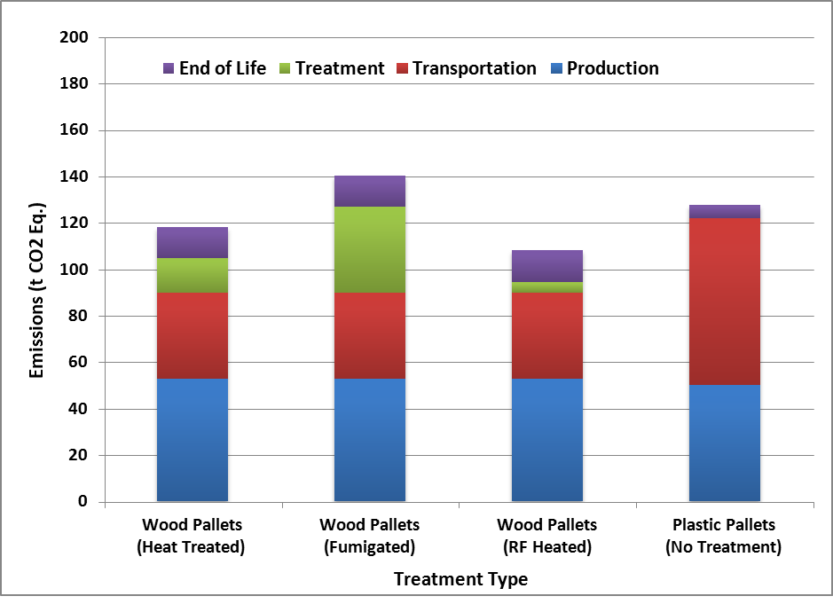
LCA Comparison of Wood and Plastic Pallets
Global Warming Impacts (Ton CO₂ eq.)
100,000 Trips
 | Wood Pallets |  |  | Plastic Pallets
 | Heat Treatment | Me-Br Fumigation | RF Heating (est) | No Treatment
Production | 52.69 | 52.69 | 52.69 | 49.95
Transportation | 37.2 | 37.2 | 37.2 | 72
Phytosanitary Treatment | 14.66 | 36.86 | 4.66 | 0
End of Life | 13.53 | 13.53 | 13.53 | 5.76
Total | 118.08 | 140.28 | 108.08 | 127.71
Life Cycle Analysis of pallet types and treatment methods
Notes:
In comparison, this graphic shows that methyl bromide treatment makes up a much larger component of the pallet life cycle carbon impact (red segment of 2nd bar) while our early estimates of radio frequency treatment predict it to be a much smaller component (red segment of 3rd bar). The first three columns of the table show that RF treatment should result in a treated pallet carbon impact approximately 10% lower than heat treatment (11.09 vs. 12.69 kg/co2 eq.) while methyl bromide treatment increases the carbon impact by about 25% over heat treating (15.95 vs. 12.69).

Slide 18
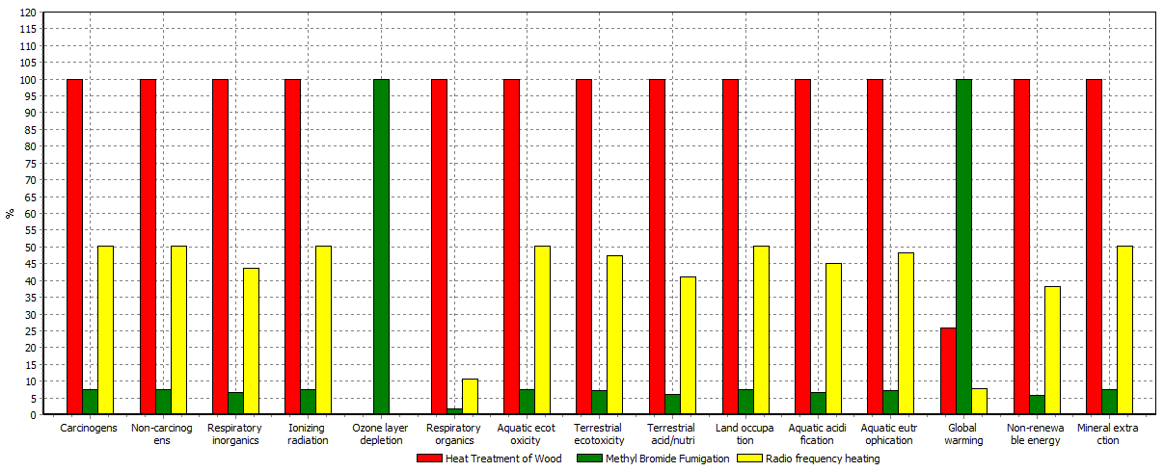
LCA of Treatment Methods
Comparing Heat Treatment, Me Br Fumigation and RF Heating
  Basis: Carbon footprint generated during the treatment of 1 pallet
  Me Br fumigation has a high Ozone Depletion Potential of 0.51
  RF Heating produces NO harmful emissions – Environmentally clean
Notes:
This graph illustrates all the environmental impacts together, normalized to 100% of the alternative with the greatest impact on each category. For instance, heat treating has the highest output of carcinogens of the three treatment methods, with methyl bromide putting out only about 7.5% of heat treatment, and RF putting out about 50%. Note that these impacts could be generated by factors other than the treatment itself, such as transportation necessary for each treatment regime. For the 15 categories, heat treatment has the greatest impact in thirteen categories, MeBr has the highest impact in two categories, and RF is not the worst treatment of the three for any environmental category.

Slide 19
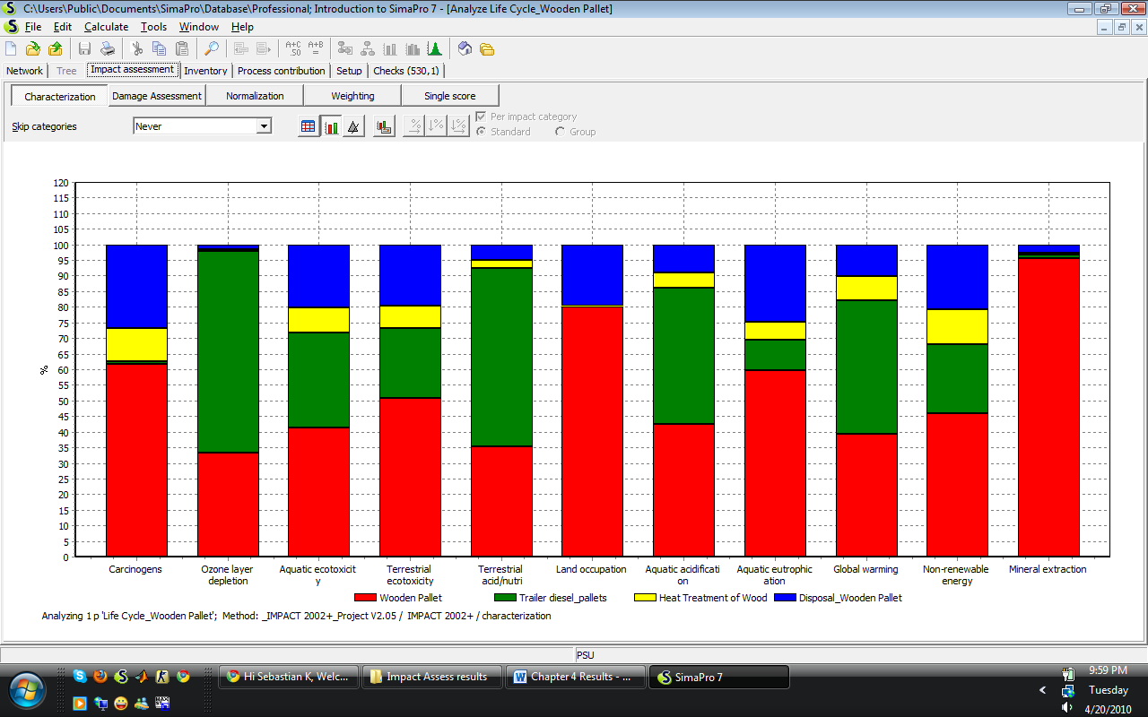
Impact by Process Component
Notes:
This chart shows the relative impact of heat treatment versus manufacturing, transportation, and disposal for each of the impact categories.

Slide 20
Impact Assessment Results (Impact 2002+)
Impact Category | Unit | HT | MeBr | RF Heating | MW Electricity from Coal Scenario 1 | MW Electricity from Coal Scenario 2 | MW Electricity from Coal Scenario 3
Carcinogens | kg C2H3Cl eq | 0.062 | 0.004 | 0.037 | 0.0000522 | 0.0000853 | 0.000101
Ozone Layer Depletion | kg CFC-11 eq | 2.70E-08 | 3.40E-03 | 1.60E-08 | 3.70E-09 | 5.51E-09 | 6.51E-09
Aquatic eco-toxicity | kg TEG water | 81.962 | 5.588 | 49.327 | 0.0294 | 0.048 | 0.0567
Terrestrial eco-toxicity | kg TEG soil | 14.395 | 0.935 | 8.192 | 0.0495 | 0.0809 | 0.0956
Terrestrial Acidity | kg SO2 eq | 0.019 | 0.0011 | 0.0093 | 0.00704 | 0.0115 | 0.0136
land occupation | m2org.arable | 0.0023 | 0.00016 | 0.0014 | 0 | 0 | 0
Aquatic Acidification | kg SO2 eq | 0.0073 | 0.00044 | 0.0039 | 0.00237 | 0.00387 | 0.00457
Aquatic Eutrophication | kg PO4 P-lim | 7.70E-06 | 5.00E-07 | 4.50E-06 | 1.34E-06 | 2.20E-06 | 2.59E-06
Global Warming | kg CO2 eq | 2.2 | 5.528 | 0.559 | 0.265 | 0.433 | 0.511
Non-renewable energy | MJ primary | 20.323 | 1.057 | 9.298 | 3.25 | 5.32 | 6.28
Mineral Extraction | MJ surplus | 0.0019 | 0.00013 | 0.0011 | 0 | 0 | 0

Slide 22
Single score comparison

Slide 23
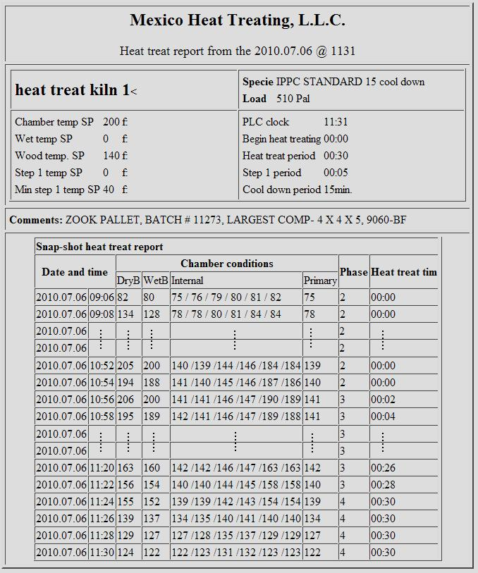
Sample data set for current ISPM standard
Notes:
To extend the study to include proposed longer heat treatment schedules, data like this was collected from a heat treater in central Pennsylvania. This data shows us how long this kiln load took in treatment and the temperatures attained at each probe in the load. It shows that the load started at 9:06 am with a lowest probe temperature of 75F; at 10:52 the lowest probe temperature reached the required treating temperature of 139F; and that minimum temperature was held until 11:30.

Slide 24
Estimation of fuel consumption per treatment schedule
HT treatment (ºC/min) | Required Minimum Temperature (ºF) | Measured Minimum Temperature (ºF) | Preheating Time (min) | Treatment Duration (min) | Kiln Operation time (min) | Fuel Consumption (BTU/pallet)
56/30 | 133 | 140 | 96.1 | 30 | 116.128 | 4775
60/60 | 140 | 147 | 105.9 | 60 | 145.897 | 5999
71/75 | 160 | 167 | 143.0 | 75 | 193.014 | 7936
Notes:
Fuel consumption was calculated based on the previous study and the average length of time required to treat to the 56/30 standard. Then, using estimates from industry experts and fundamental equations, fuel consumption was estimated for the longer proposed schedules.

Slide 25
CO₂ Emission Comparison
Notes:
From these fuel consumption calculations, the increased CO2 emissions were estimated for the proposed schedules.

Slide 26
Loads Treated per Day
Notes:
A more significant impact was that of the additional time to finish treatment. The bottom bar indicates that the typical treater can heat treat three loads in an 8-5 work day on the current ISPM standard, but those three loads would take until after 7pm on the 60C/60M schedule, and until after 9:30 pm on the 71C/75M schedule. The 60/60 option might not hurt too much, because the last load could be loaded before 5 and left to run and shut down automatically, but with seasonal variation, the 71C/75M schedule would often reduce the treaters’ capacity to only 2 loads per day.

Slide 27
Longer treatment time incurs opportunity cost for the industry
Notes:
Lower production and/or overtime wages associated with the longer schedules will cost the treaters, either in opportunity cost for lower production capacity or higher costs in extended or additional work shifts. This graph shows that these costs could increase as much as 43 cents per pallets under the longer schedule, which is a treatment cost incre.ase of around 150-175% per pallet

Slide 28
Conclusions
Methyl Bromide fumigation produces the largest global warming/ozone depletion impacts of the treatment types
Conventional heat treatment produces the largest impact of treatment alternatives in all other environmental categories
Microwave and RF treatment both produce lower life-cycle impacts in all categories than conventional Heat Treatment and Methyl Bromide fumigation
Wooden pallets with conventional or MW/RF heat treatment incur an overall carbon footprint approximately 10 - 20% lower during their life cycle than plastic pallets or wooden pallets treated with methyl bromide fumigation
Plastic pallets do not present a clearly demonstrable environmental advantage over treated wooden pallets across all impact categories
Proposed longer heat treatment schedules create additional environmental impacts, and will increase the cost of treatment significantly
Increasing cost of wood pallet use for further phytosanitary protection may transition the huge global pallet market toward alternatives with greater environmental impact
Life Cycle Analysis of pallet types and treatment methods

Slide 29
To be continued…

